Slide 1
BMKALC Survey of Parish and Town and Community Councils 2021
The Association aims to deliver the services that our members are looking for and this survey will hopefully enable us to better understand what you feel we should address over the coming years.

Slide 2
Introduction
During August and September BMKALC undertook a comprehensive survey of both clerks and councillors across the county.
The purpose of the survey was to gather a background picture of our local councils, to identify area where the Association needs to improve and to understand the training needs of both clerks and councillors as well as the challenges that are currently being faced or are expected to be faced in the future.

Slide 3
Introduction - Councillors
Our members are going through periods of change so as an Association we cannot stay as we were and remain effective. With this in mind we would like to understand from you as Councillors what are the challenges and issues that you are experiencing, those that you expect to face in the future and the types of services and support that you will look to BMKALC to offer so that you can be most effective.

Slide 4
Respondents
A total of 120 town and parish councillors from across Buckinghamshire and Milton Keynes completed Q1 of the online* survey however not all answered subsequent questions therefore the numbers in each slide reflect those who chose to answer that particular question.
* A paper version of the survey was available for those who requested it.

Slide 5
The results of the survey will be used to form the basis of future development and action plan for the association to enable BMKALC to provide a better service to the members. The survey was available for six weeks and ran until 15th October 2021.
Results

Slide 6
Q1 Responses
Which Town, Parish or Community Council do you sit on?
Councillors from across the county took part in the survey but are too numerous to list here.

Slide 7
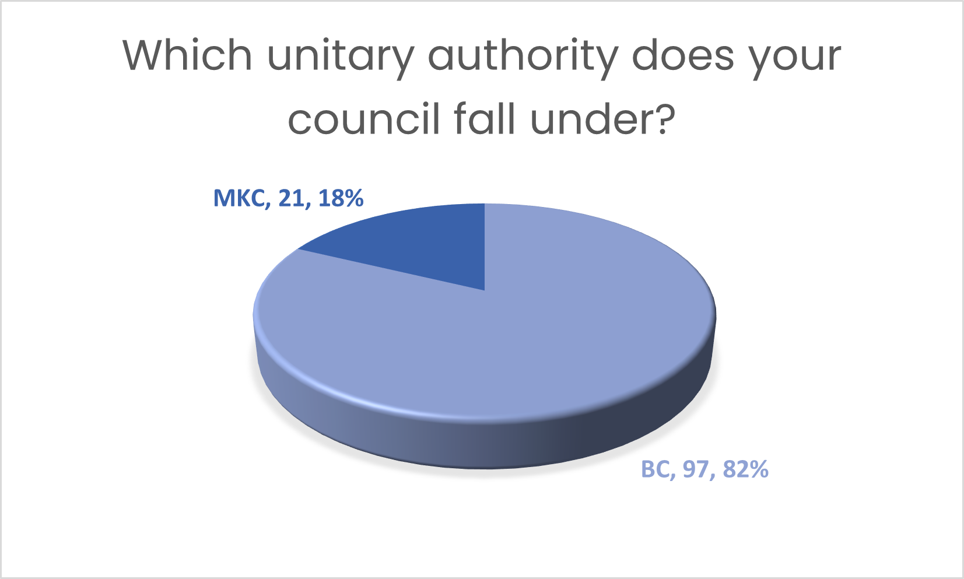
Q2 Responses

Slide 8
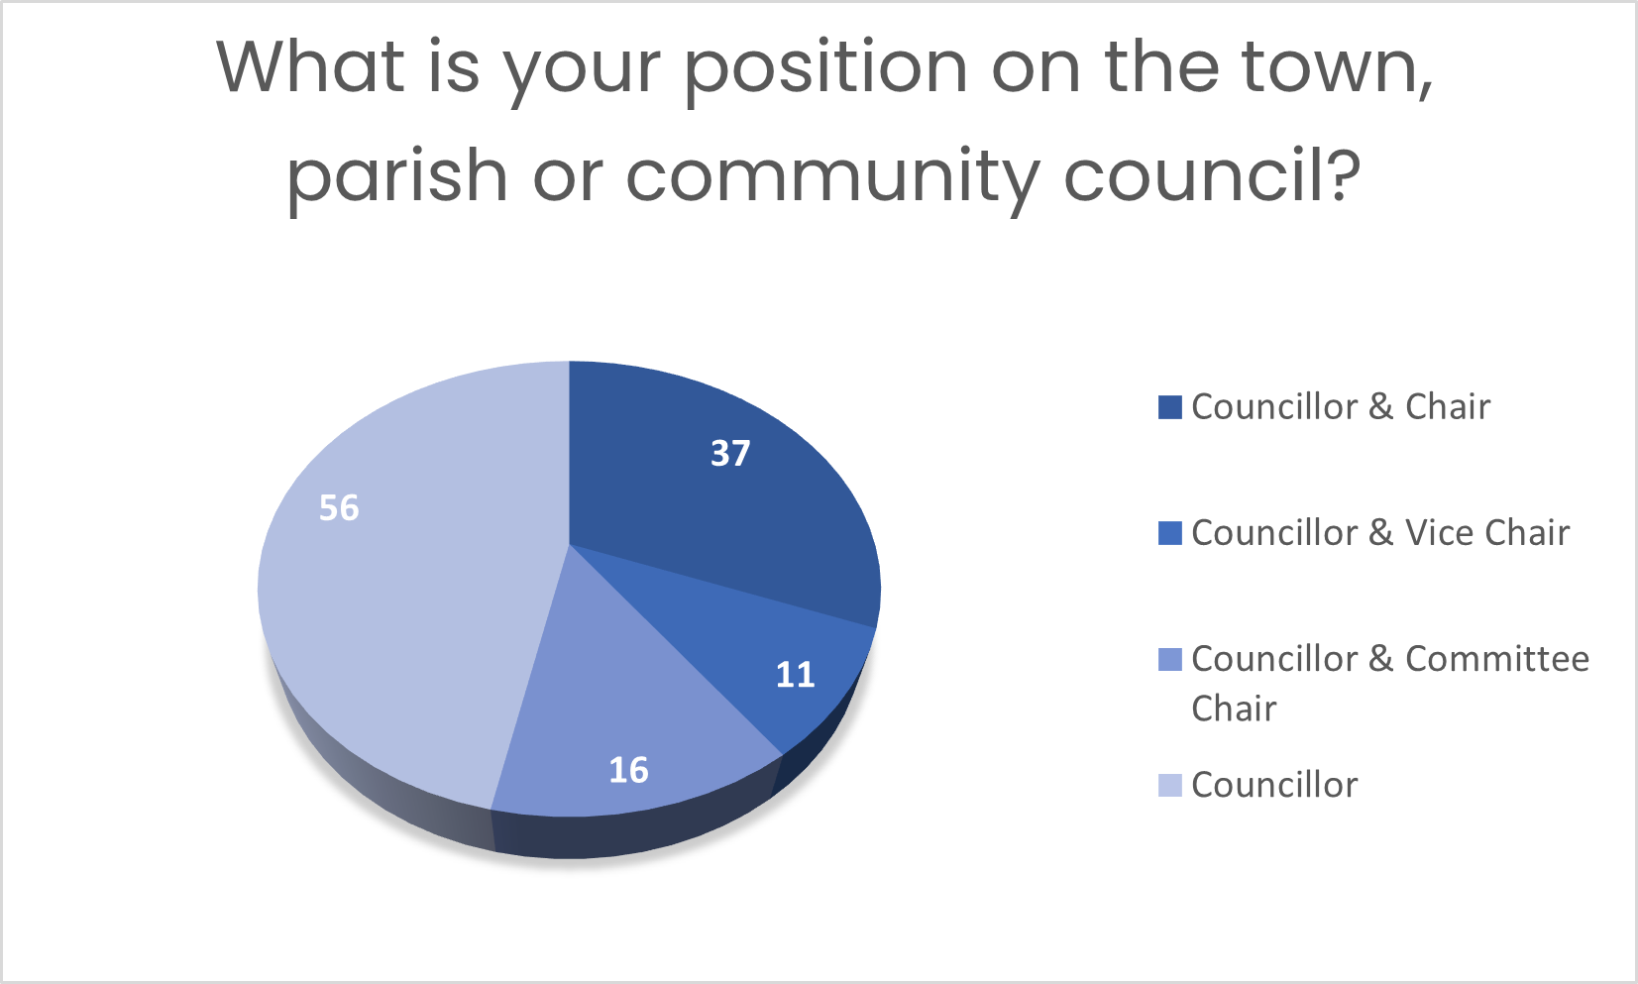
Q 3 Responses

Slide 9
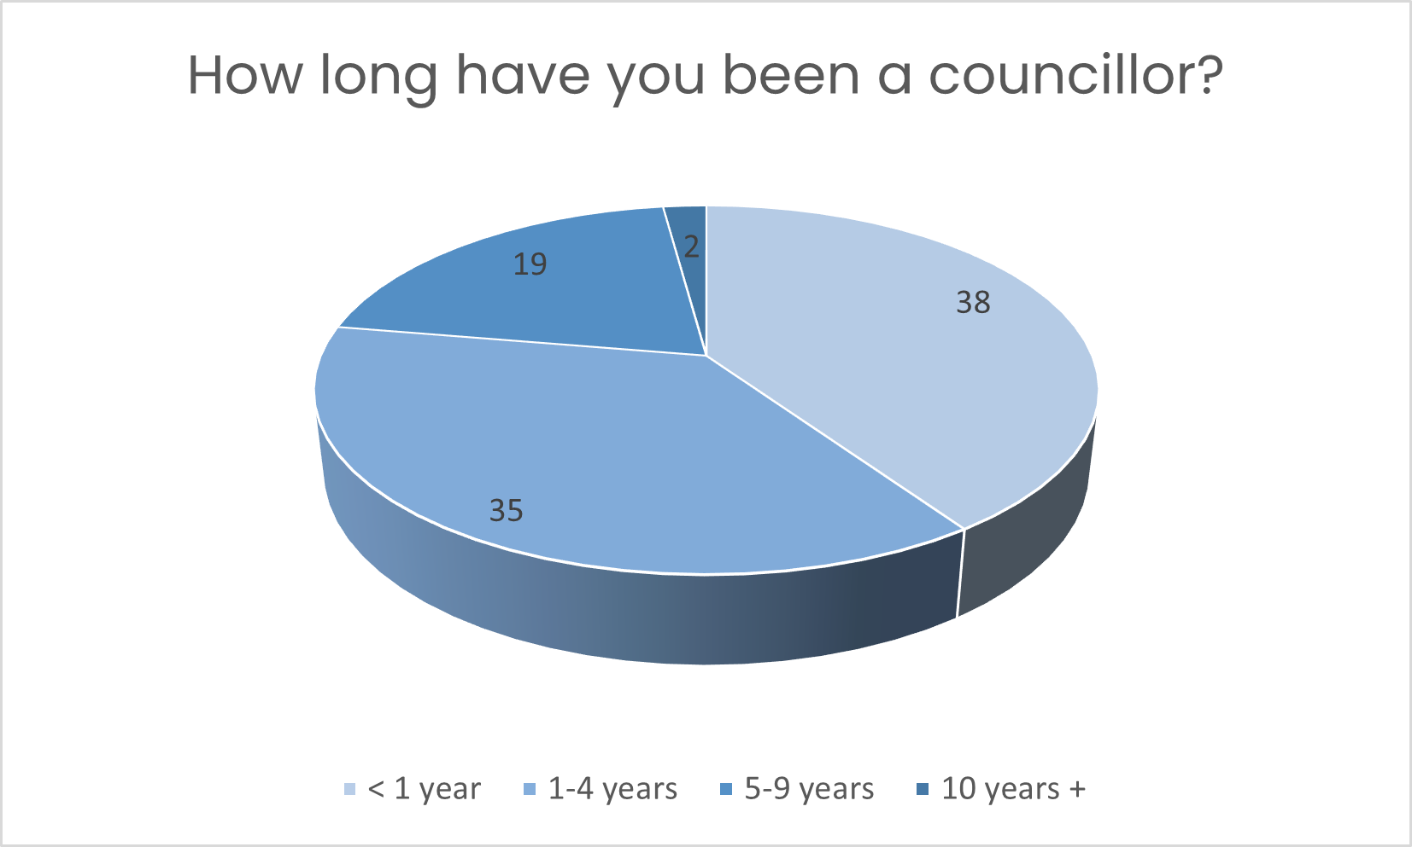
Q4 Responses

Slide 10
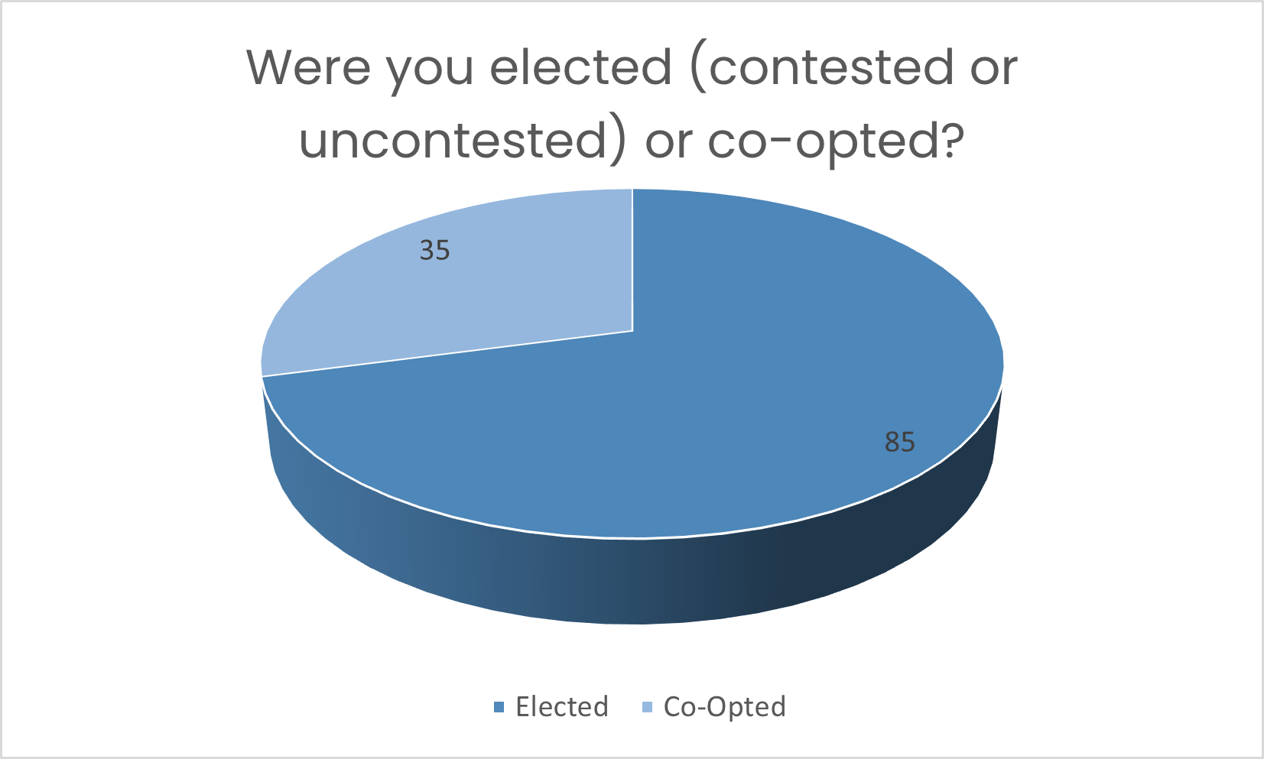
Q5 Responses

Slide 11
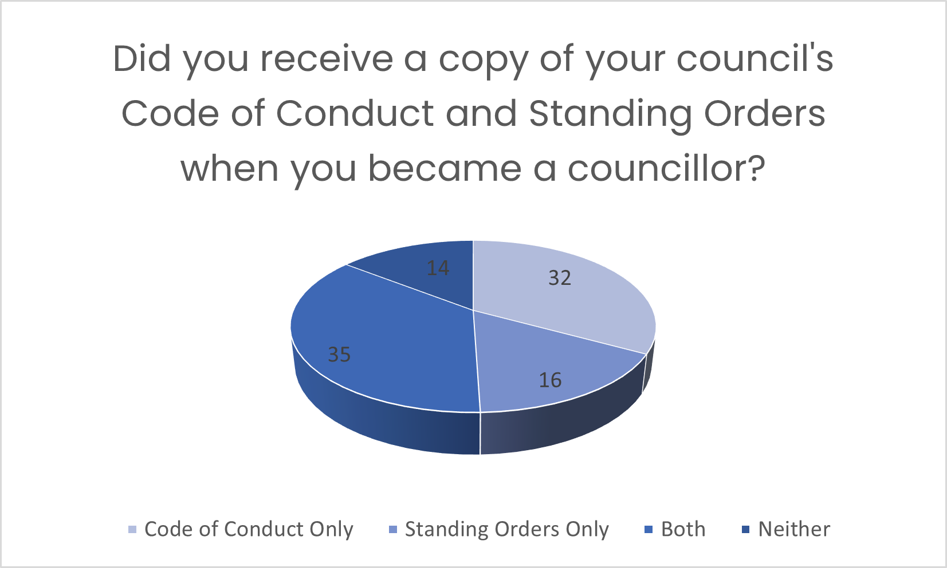
Q6 Responses

Slide 12
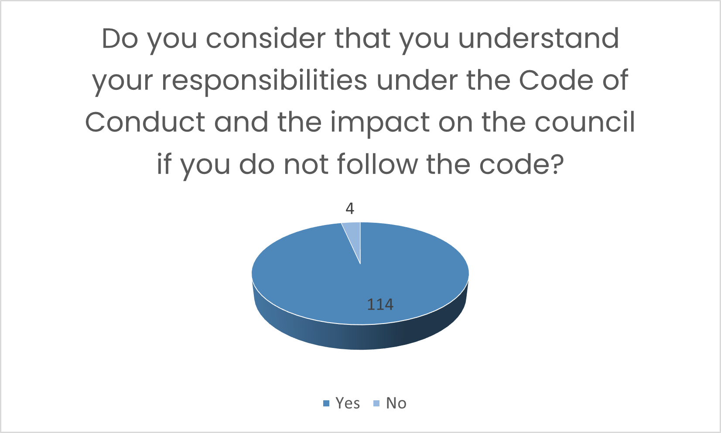
Q7 Responses

Slide 13
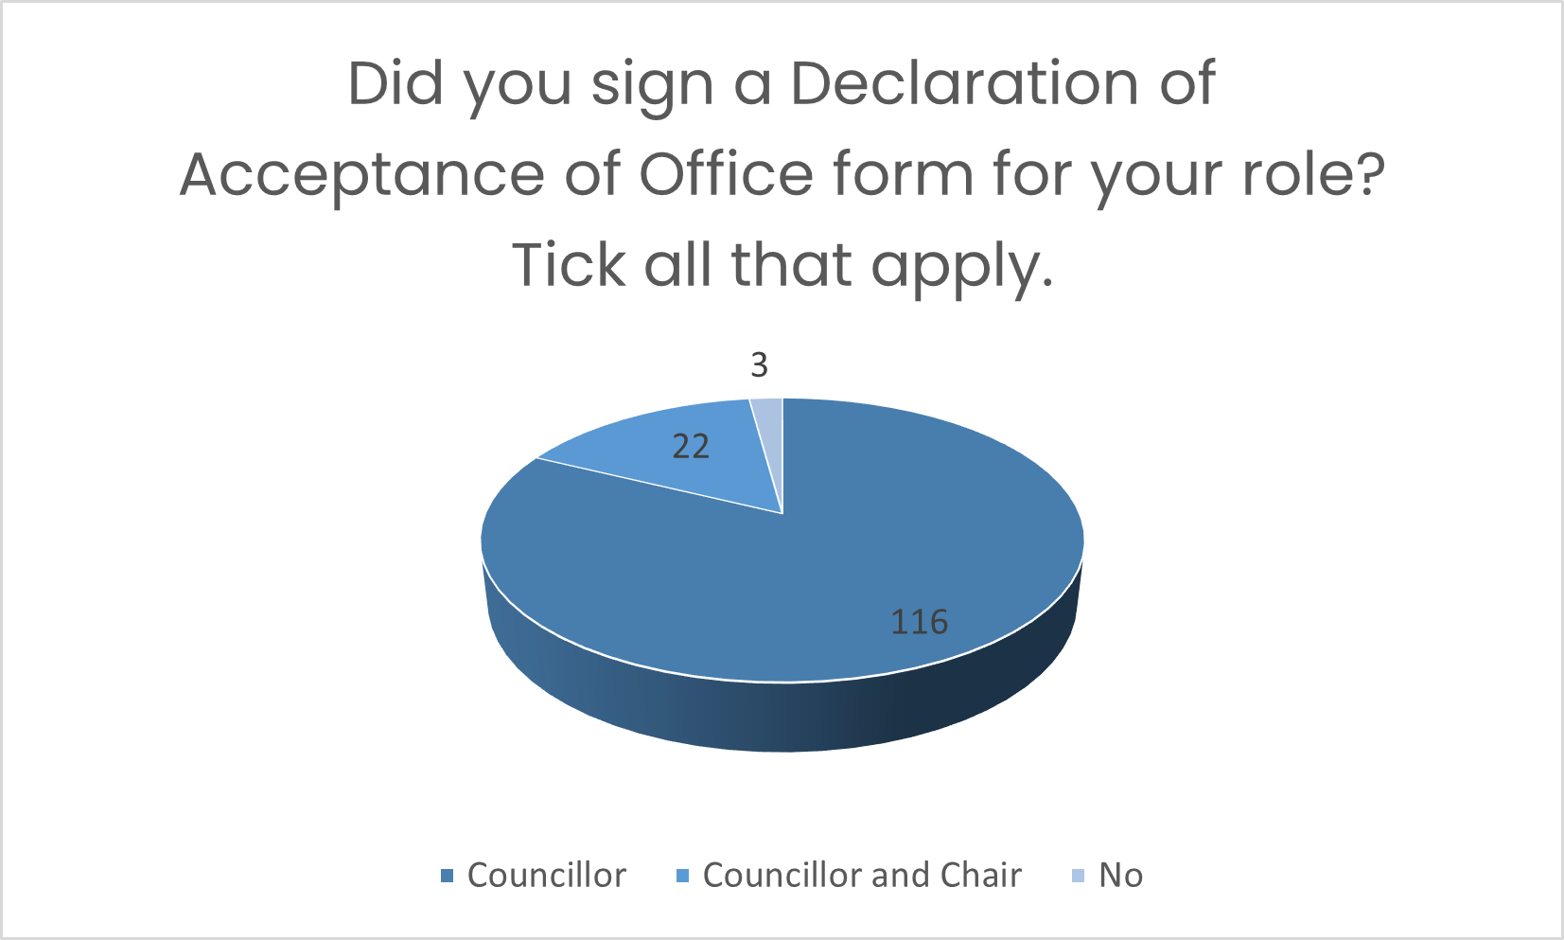
Q8 Responses

Slide 14
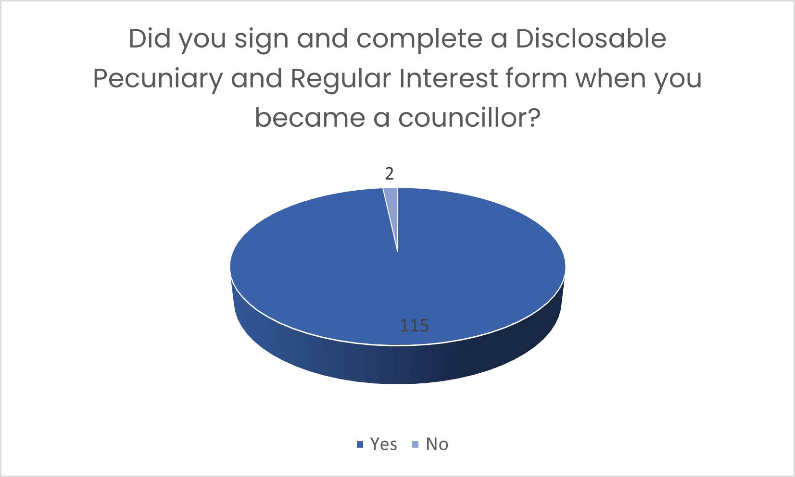
Q9 Responses

Slide 15
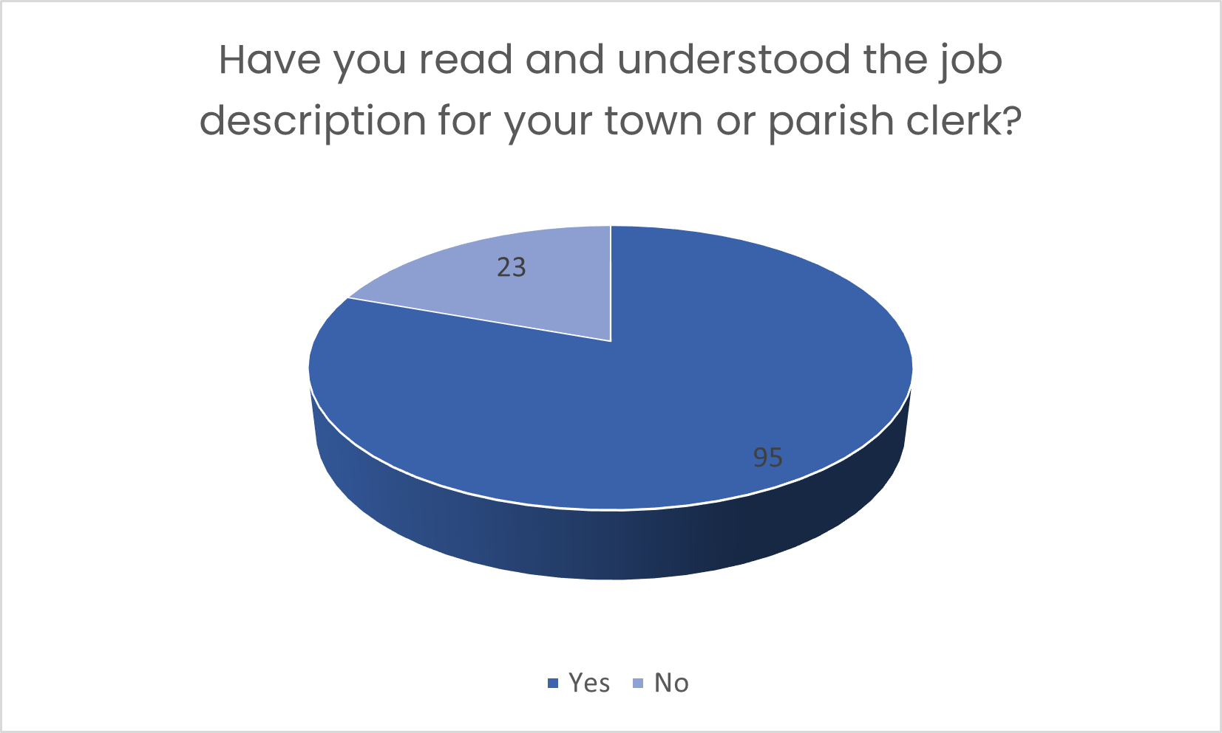
Q10 Responses

Slide 16
Q11 Responses

Slide 17
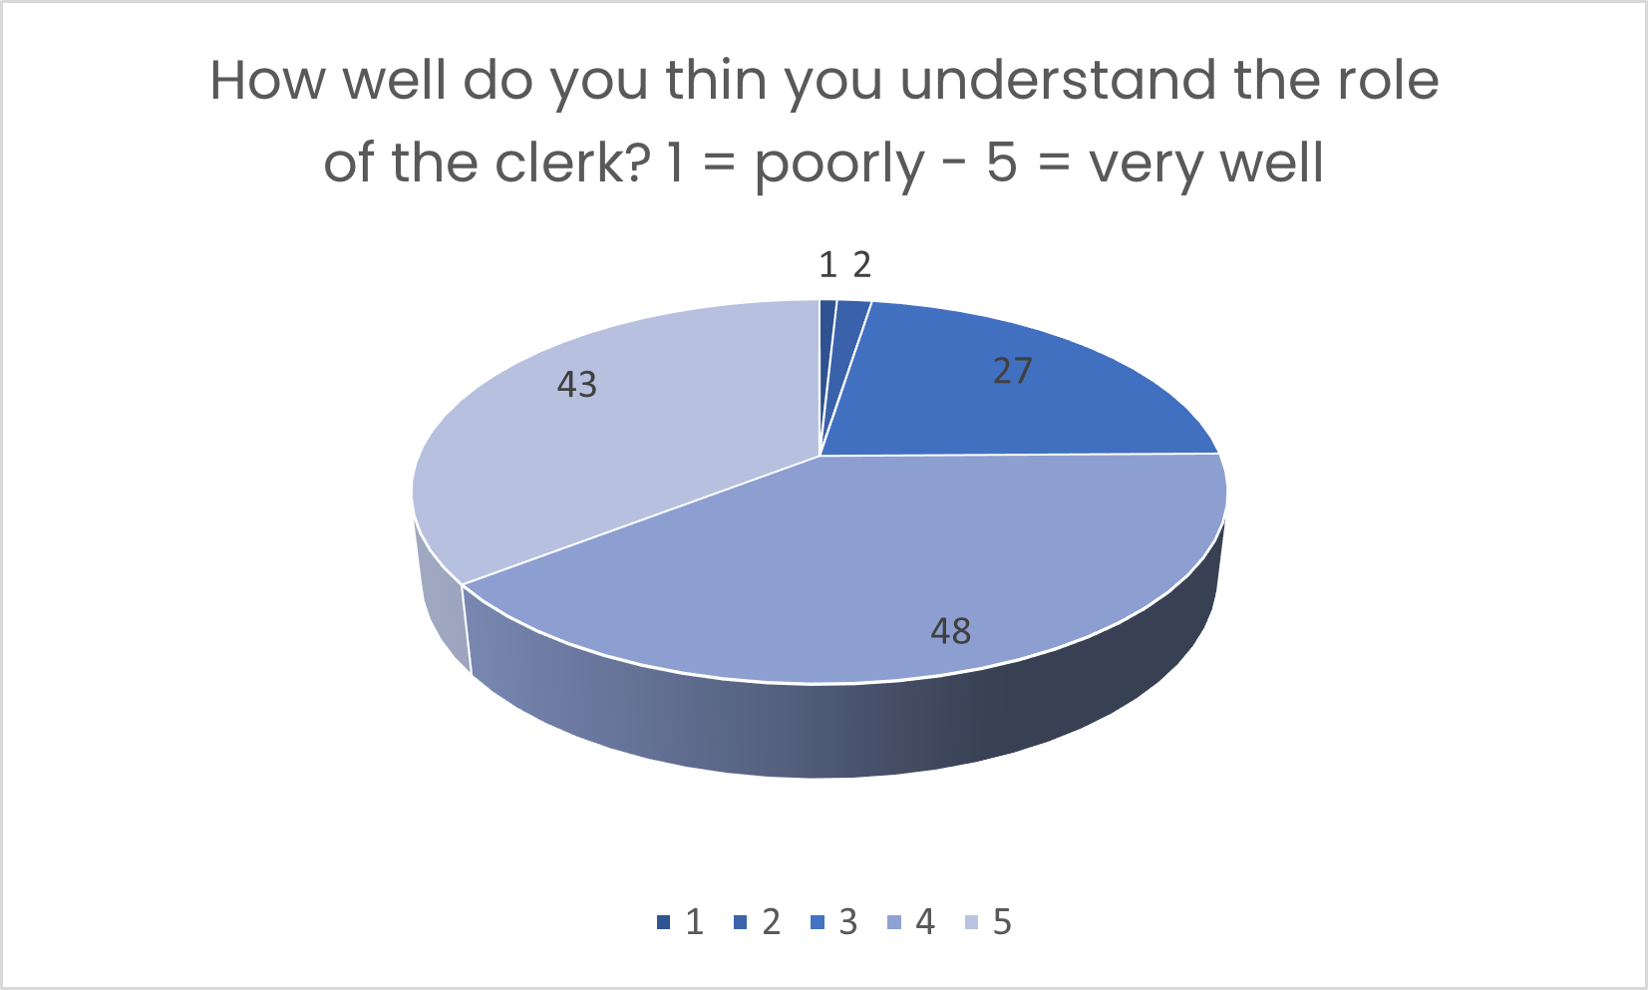
Q12 Responses

Slide 18
Q12 Responses
Please explain your ranking for Q12.
In summary:-
Those who were not so familiar stated that it was due to being new to the role.
Those who were familiar said that their clerks had ensured that the role was understood and that good communication helped with understanding.

Slide 19
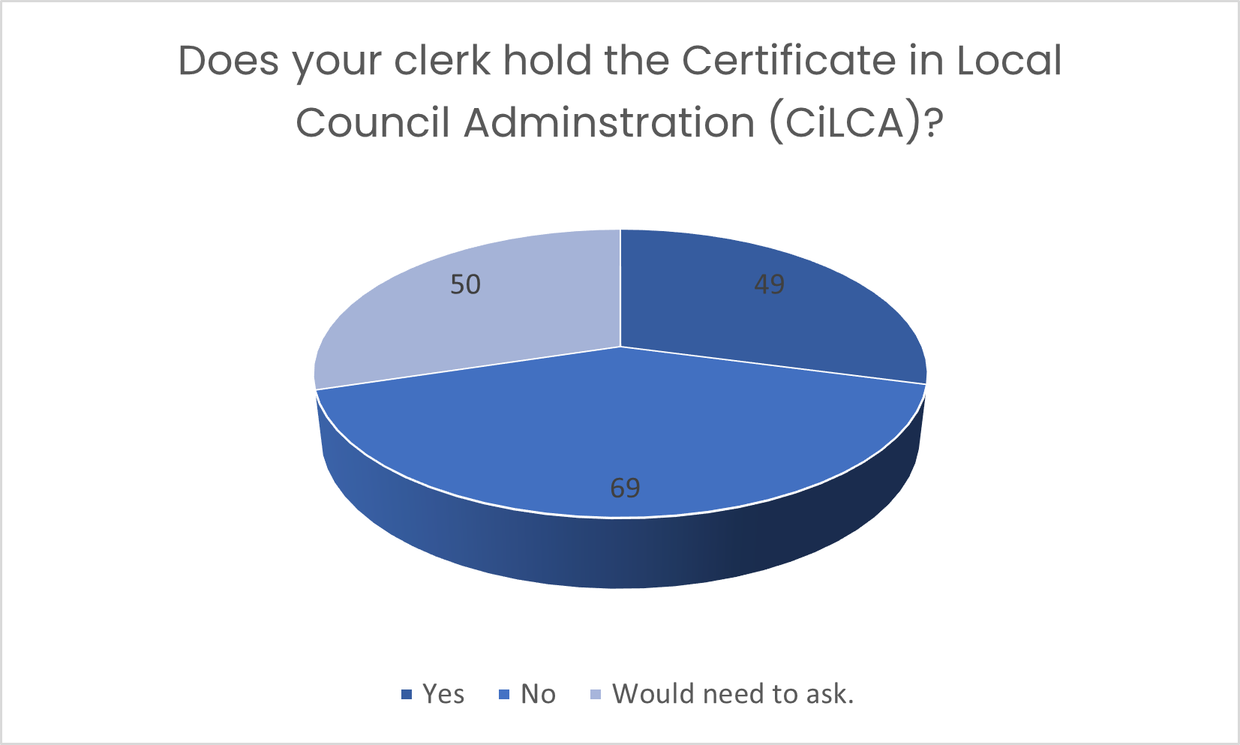
Q13 Responses

Slide 20
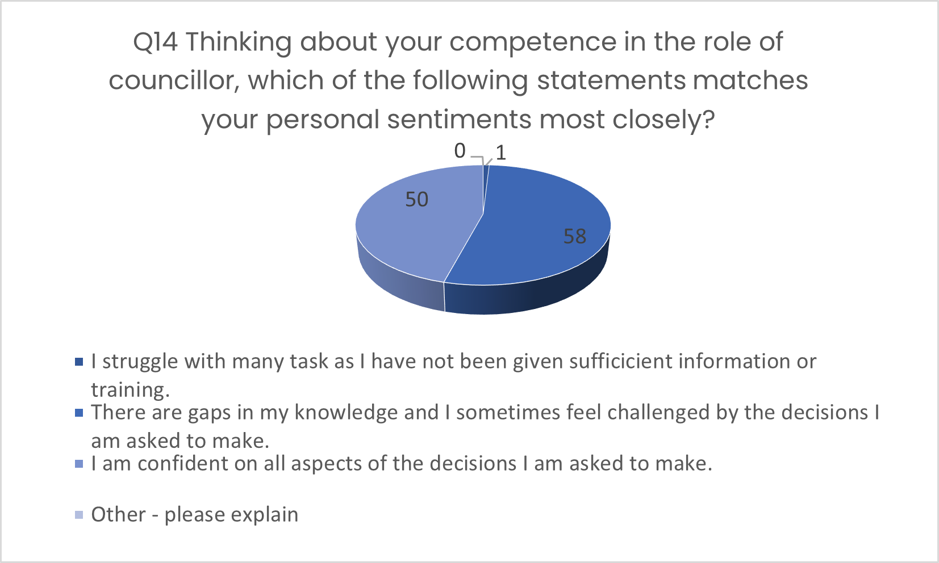
Q14 Responses

Slide 21
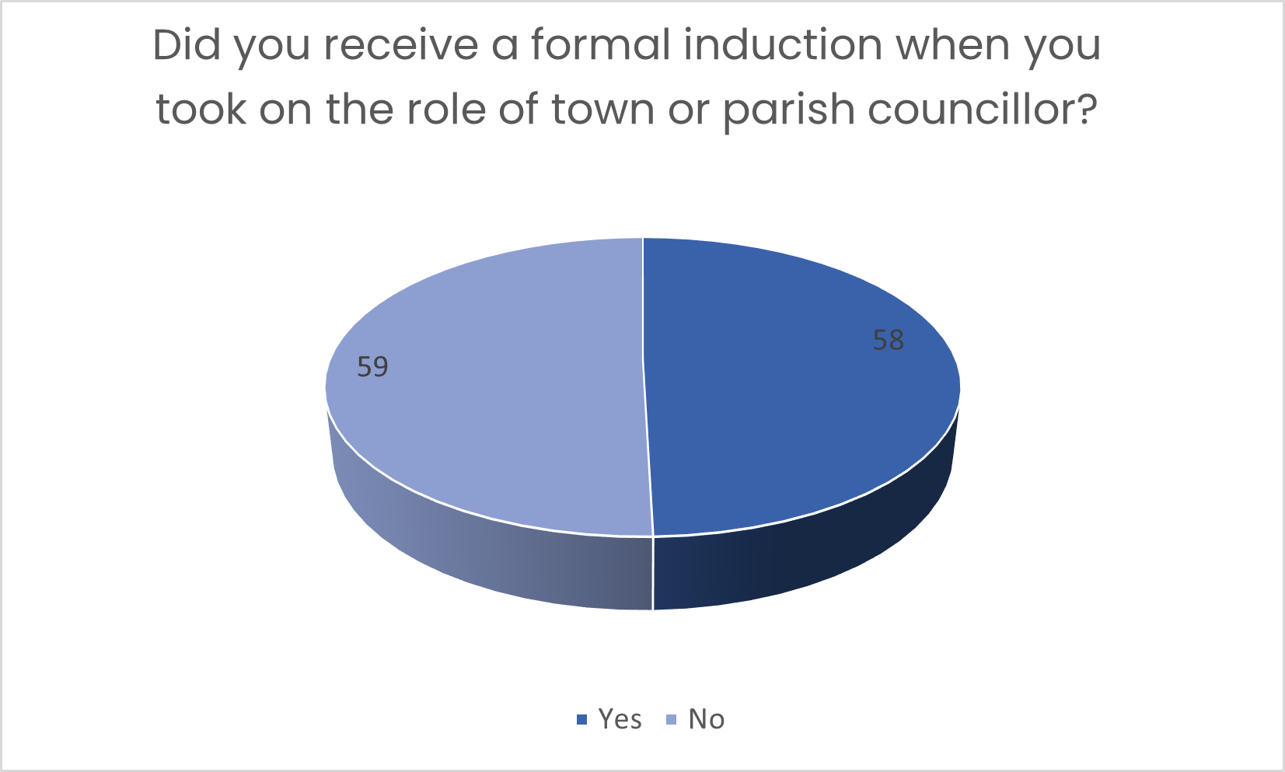
Q15 Responses

Slide 22
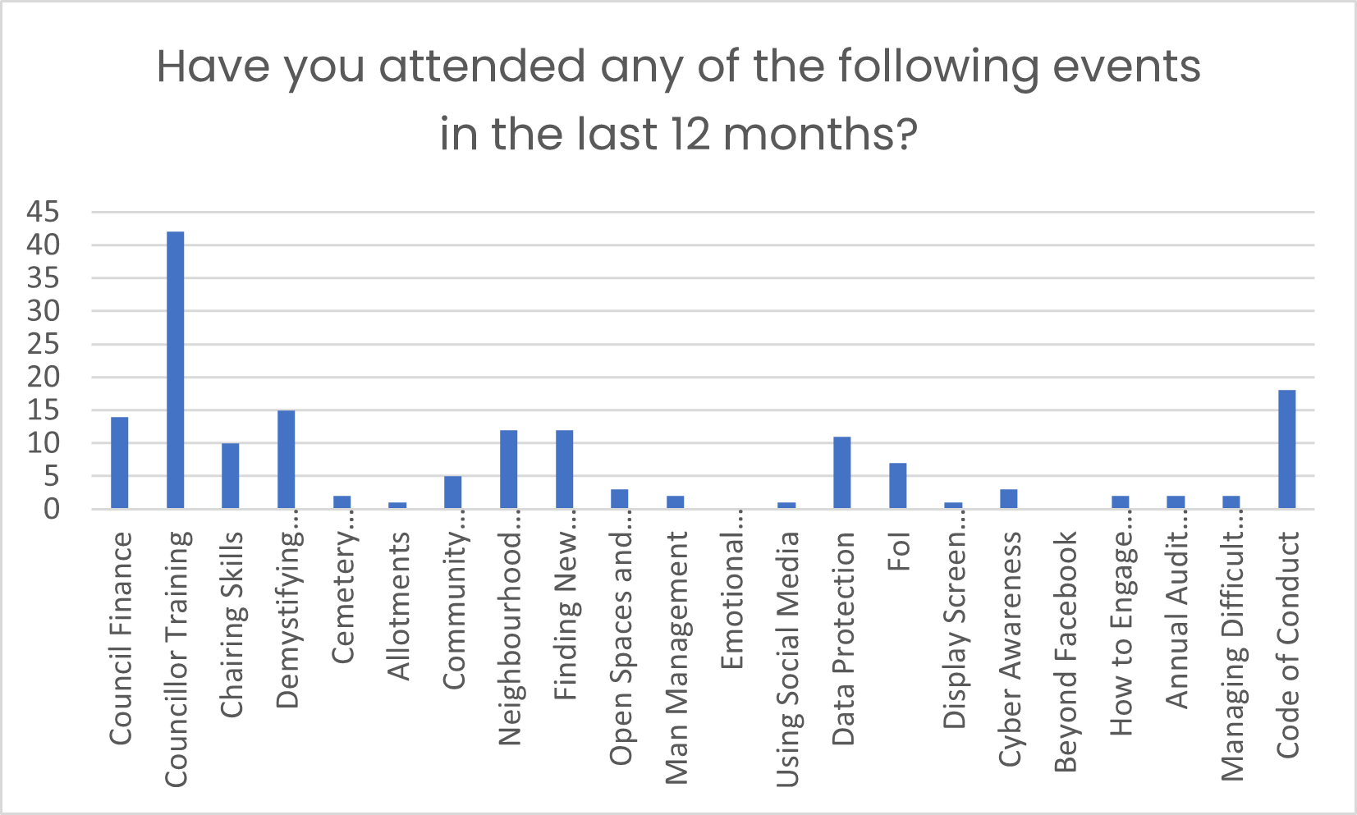
Q16 Responses

Slide 23
Q17 Responses
If you have not attended any training session, please can you tell us why?
The following five statements summarise the responses.
Do not get invited.
The courses are not offered to me.
I have already done the courses.
I wasn’t aware of the courses.
I am too busy.

Slide 24
Q18 Responses
Are there any further areas of training which would be useful to you in your role? If so please list them.
Planning projects
Finance
Conflict management – councillors
Community Engagement
Engagement with TfB
Neighbourhood Plans
Planning
Open Spaces
How the Standing Orders apply
General Power of Competence

Slide 25
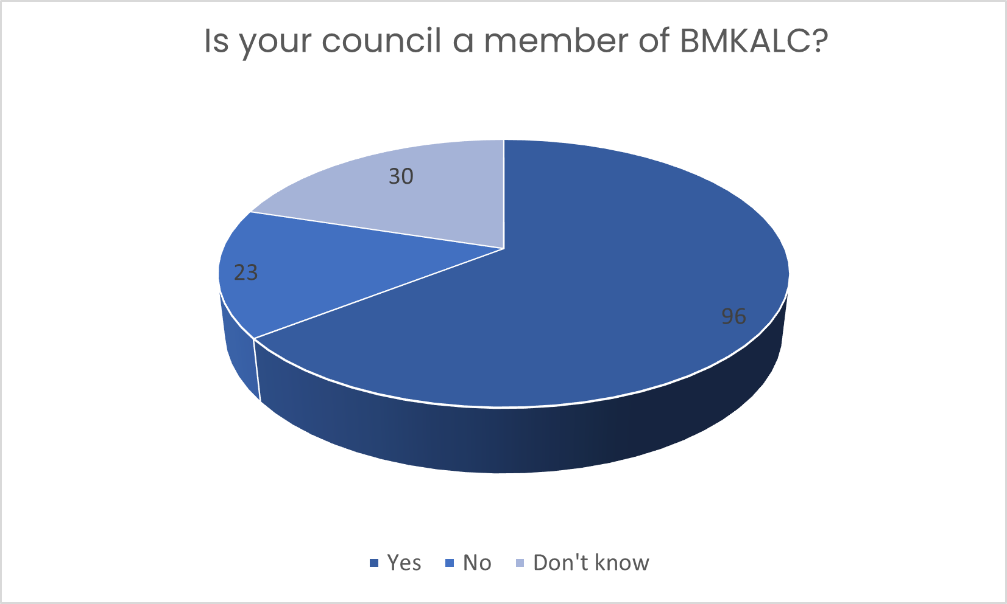
Q19 Responses

Slide 26
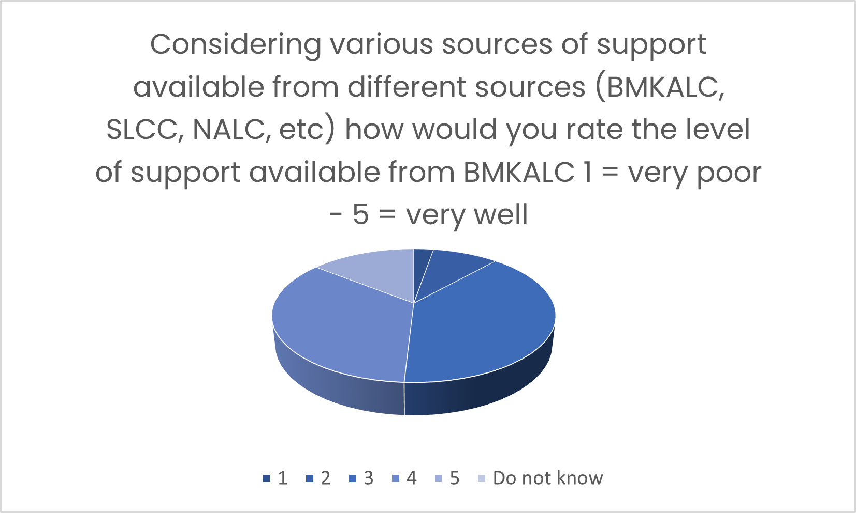
Q20 Responses

Slide 27
Q20 Responses
Please explain your rating
There were no responses to this.

Slide 28
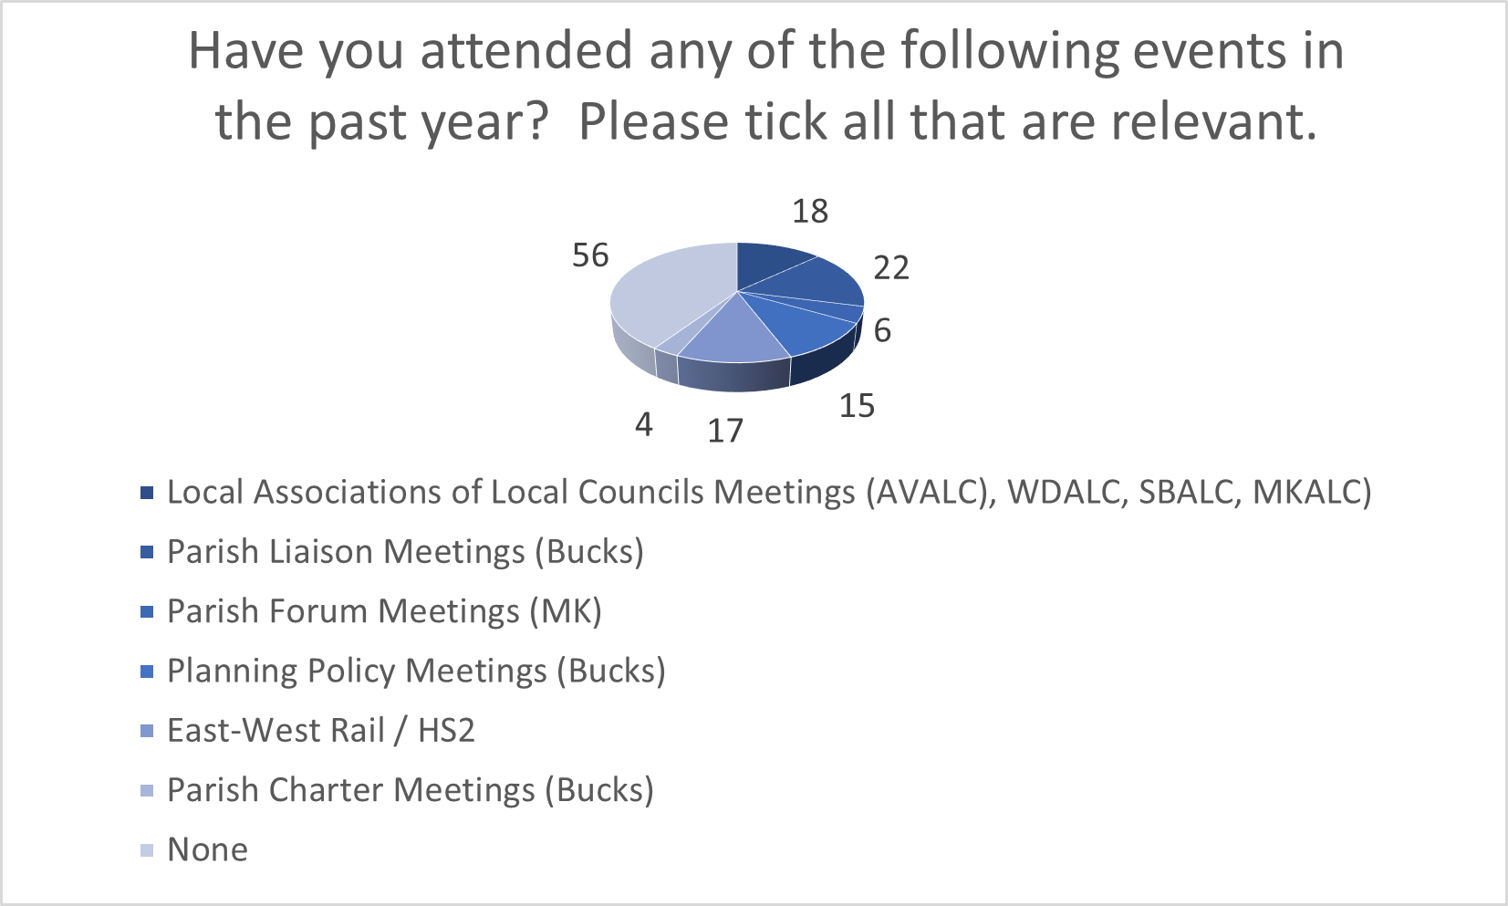
Q21 Responses

Slide 29
Q22 Responses
If you have not attended (see Q21), please explain why. Most councillors chose not to comment.
I am not invited.
I don’t know what is available.
I am new and was not aware of these.
Lack of time.

Slide 30
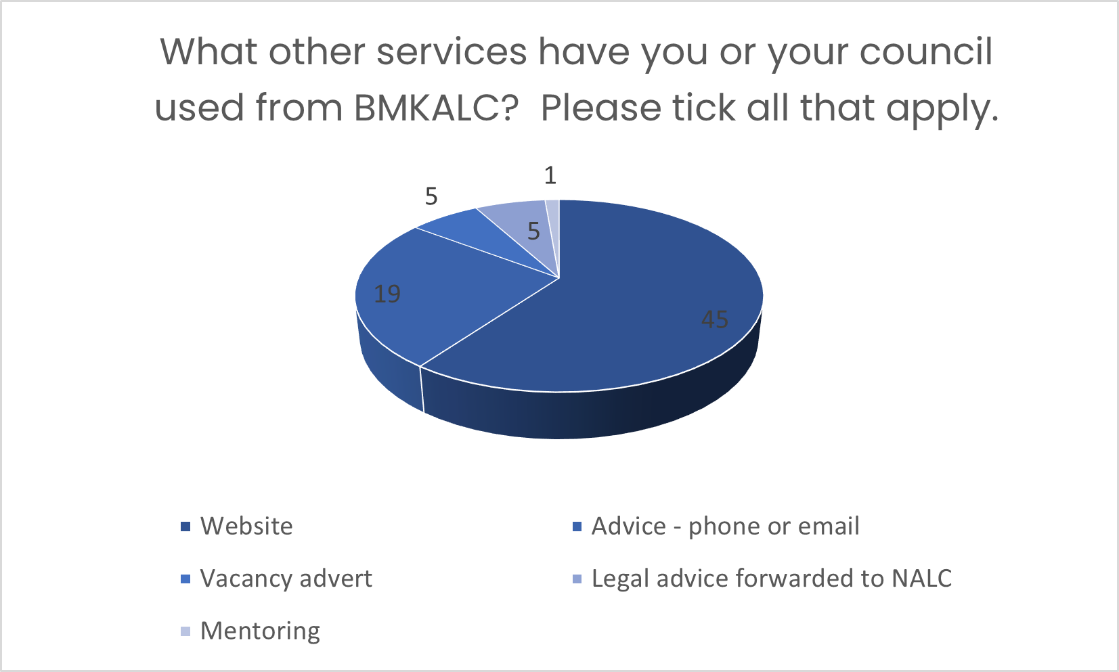
Q23 Responses

Slide 31
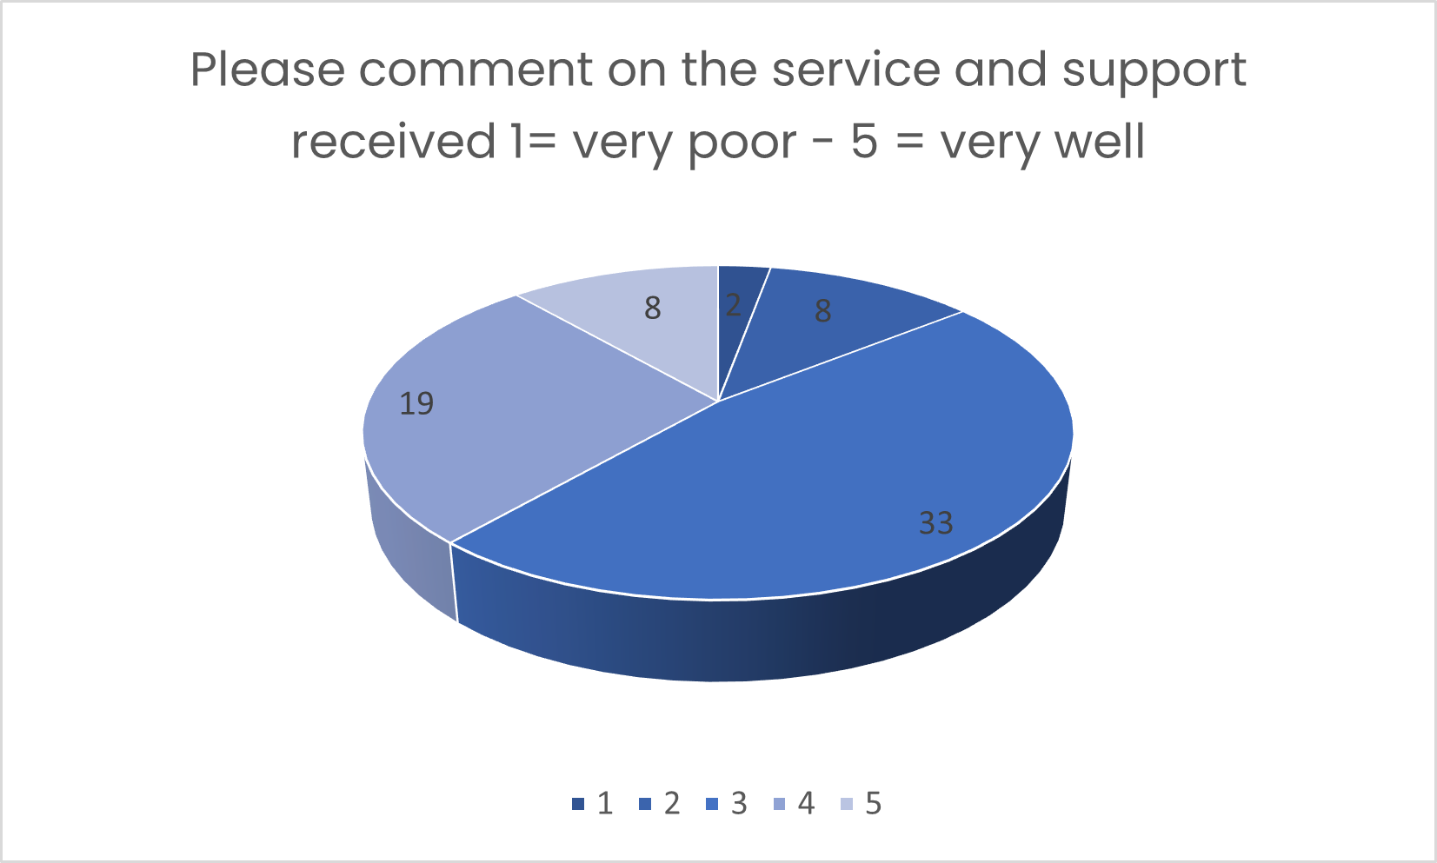
Q24 responses

Slide 32
Q25 Responses
Are there any other services that you would like BMKALC to consider providing or undertaking to improve the service to you and your council?
Re-engaging after Covid
How to influence the planning process
Budgeting for devolved services
Finances
Resident engagement
How to make changes on a small budget
Climate change
Improving communication with BC
Engaging with younger members of the community
Planning for rapid growth without supporting infrastructure
Recruitment of suitable councillors

Slide 33
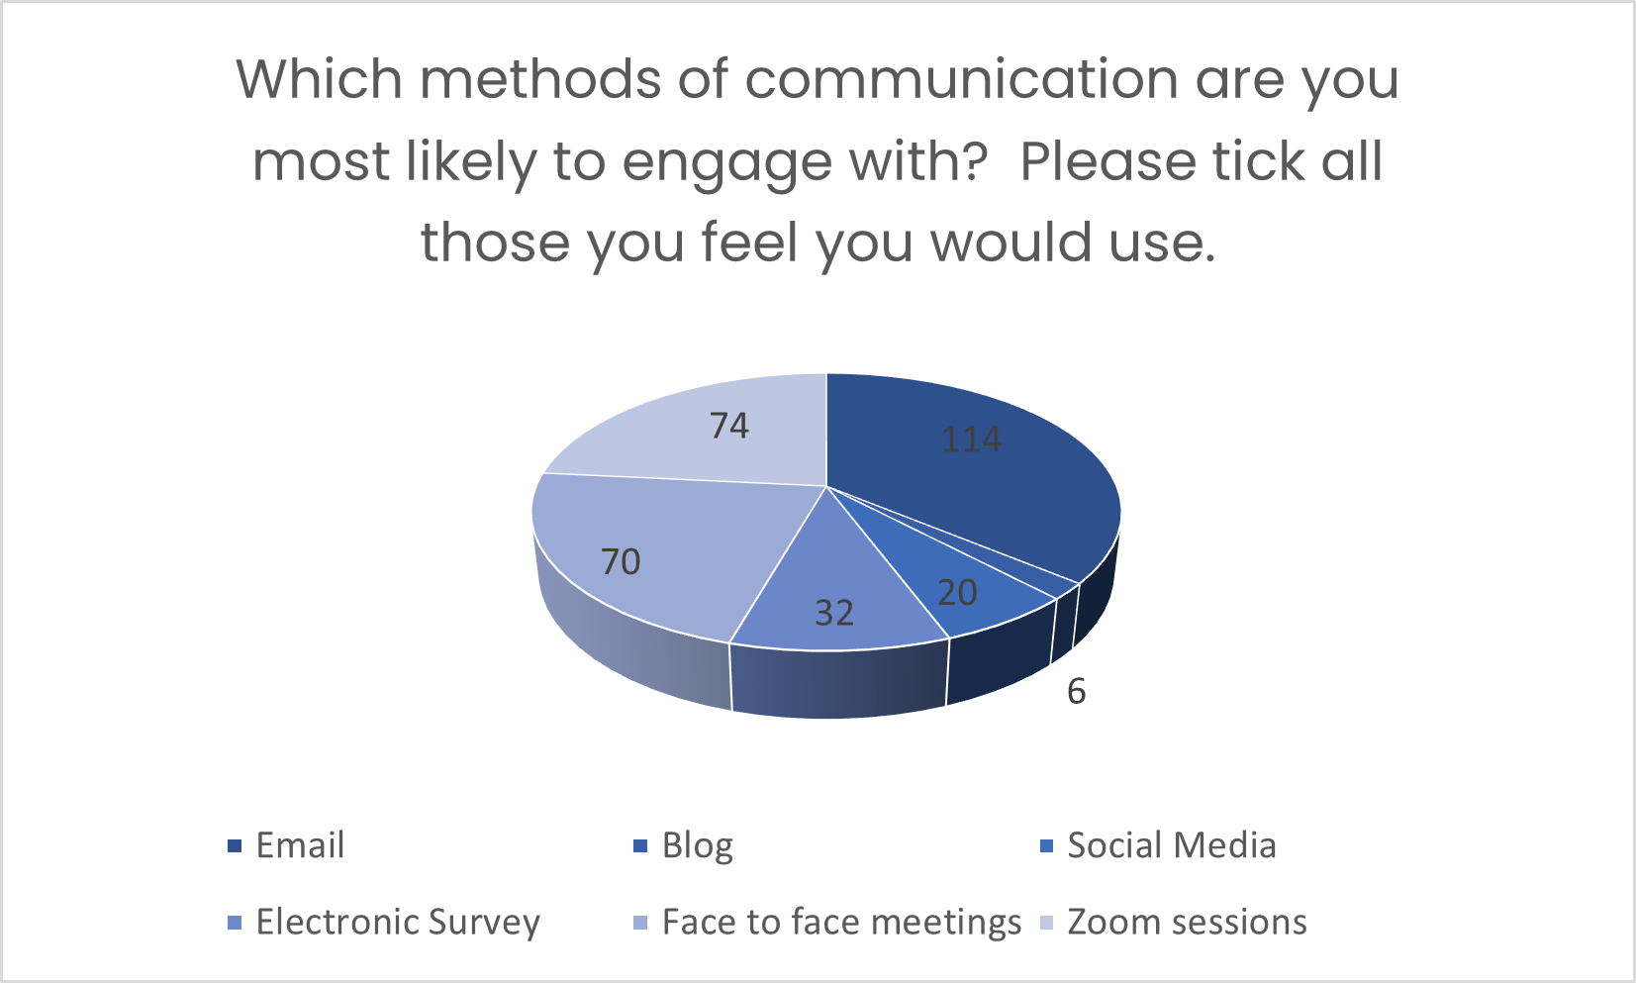
Q26 Responses

Slide 34
Q27 Responses
What do you believe are the biggest challenges facing your town or parish council over the next two years?
Re-engaging communities / residents
Budgets and finance
Planning – inability to influence
Climate change
HS” disruption
Engagement with BC

Slide 35
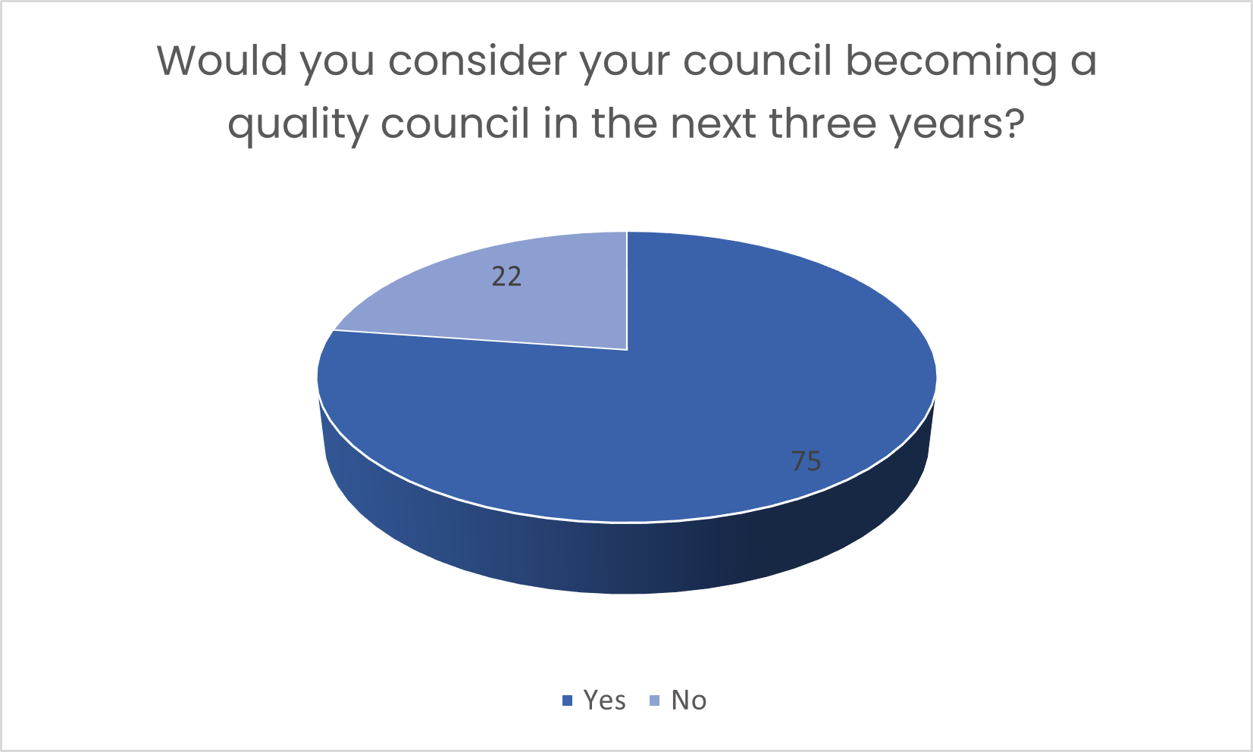
Q28 Responses

Slide 36
Any further comments
Very few responses received.
What is a ‘Quality Council’?
It is challenging being a young councillor.
BMKALC is already well run.

